Slide 1

Artificial intelligence and its use in various fields in everyday life

Slide 2





Chatbots and AI Image Generators
Plan
Finance services
Security, Surveillance and Criminal justice
Health care
Face detection, Smart devices and Navigation
Video games

Slide 3

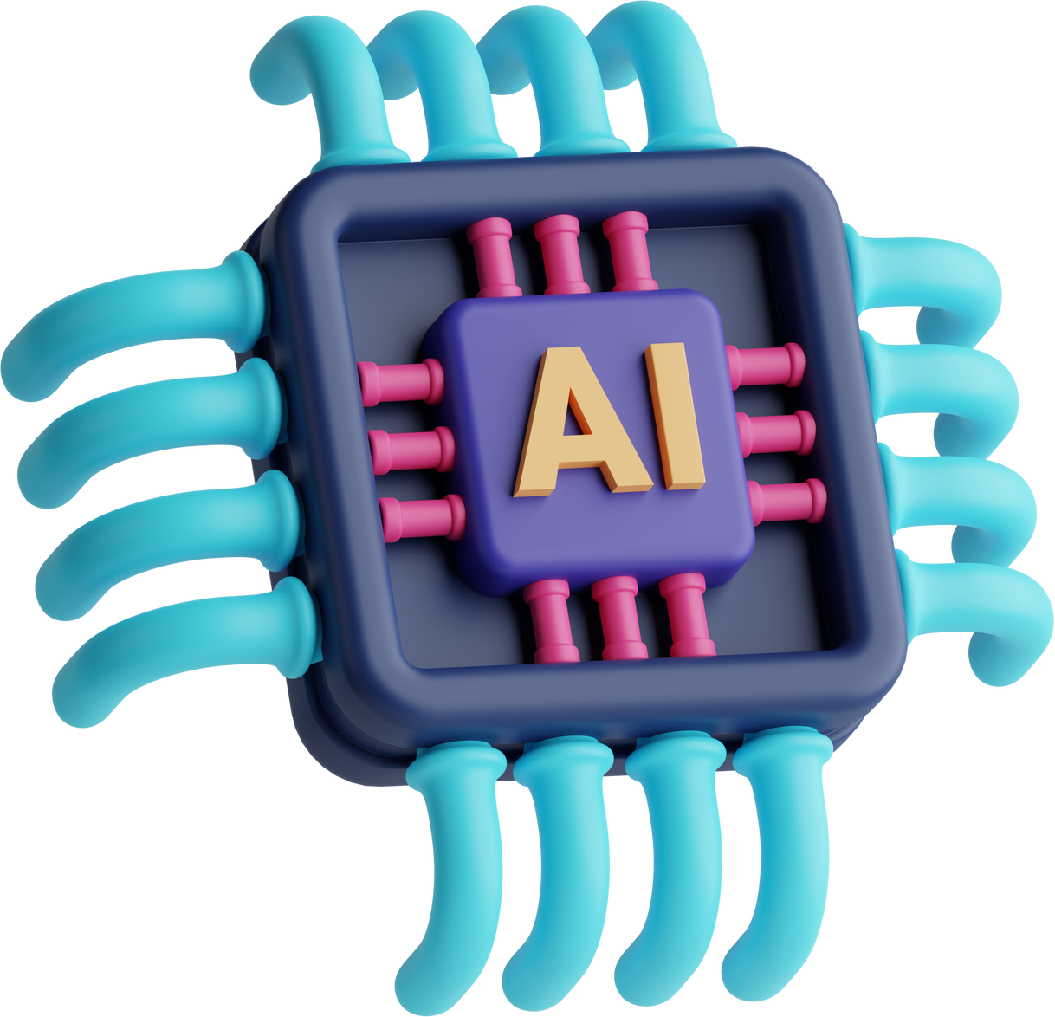
Introduction
Artificial intelligence and technology have revolutionized our lives, economies, and societies. AI, a branch of computer science, creates intelligent machines that imitate human tasks. It is used in various applications like recommendation algorithms, chatbots, forecasting, and optimization. AI in the workplace boosts productivity and job satisfaction, allowing people to focus on unique skills. Its impact spans across industries.

Slide 4

Chatbots and AI Image Generators
ChatGPT is an artificial intelligence chatbot that recreates human-like conversations and is capable of performing a variety of online tasks. In addition, advances in artificial intelligence have made it possible to generate complex images using a range of AI technologies. Image generators such as Midjourney can create vivid and engaging visuals that are as good as, and in some cases better than, those created by human artists, demonstrating the potential of AI in the creative industry.

Slide 5

Finance services
Banks have embraced technology advancements, shifting from physical spaces to mobile platforms for conducting operations. AI plays a crucial role in various banking areas, such as fraud detection, customer analysis, and service provision. Notifications from banks regarding transactions on new devices exemplify the use of AI in identifying potential fraud. Furthermore, AI analyzes customer preferences, requirements, and financial status to offer personalized product recommendations, enhancing the banking experience.

Slide 6

Security, Surveillance and Criminal justice
Artificial intelligence is transforming video surveillance by automating monitoring operations and using machine learning techniques. This allows observers to focus on critical situations, while AI software performs ongoing monitoring and detects anomalous activity that may not be noticed by human observers. However, concerns have been raised about the potential misuse of AI algorithms and their impact on privacy and fairness. For example, Chicago's AI-powered “Strategic Target List" has been criticized for disproportionately targeting people of color. Despite the concerns, countries like China are rapidly deploying AI-based surveillance systems, integrating various data sources to enhance law enforcement and national security.

Slide 7

Health care
AI tools enhance healthcare design by improving computational sophistication. For example, Merantix applies deep learning to medical imaging, enabling automated detection of lymph nodes in CT scans. This saves time and costs compared to manual analysis by radiologists. AI also plays a role in predicting challenges and allocating resources for congestive heart failure, reducing hospitalization rates and costs for senior citizens.

Slide 8

Face detection, Smart devices and Navigation
Face detection is a groundbreaking technology that enables devices to accurately identify and analyze human faces. By utilizing facial recognition, smart devices can offer tailored experiences and enhance security measures. Additionally, navigation systems equipped with advanced algorithms and sensors provide precise and efficient guidance, making travel more convenient and enjoyable. As these technologies continue to evolve, they play a crucial role in shaping a future where our devices seamlessly adapt to our individual needs and preferences.

Slide 9

Video games
AI is increasingly prevalent in video games, enhancing realism and gameplay across various genres like racing, shooting, and strategy games. By incorporating AI technology, game developers strive to create immersive gaming experiences for players. Additionally, companies are actively developing games to analyze player patterns and refine their algorithms, leading to continuous improvements in gaming AI.

Slide 10

Сonclusion
Artificial intelligence is undeniably impacting our lives through personalized recommendations and autonomous vehicles, with its expanding capabilities and potential applications. However, responsible and ethical development is crucial to ensure AI benefits humanity, making it clear that AI will shape our society and daily lives in the future.

Slide 11



Thank you!

